Slide 1
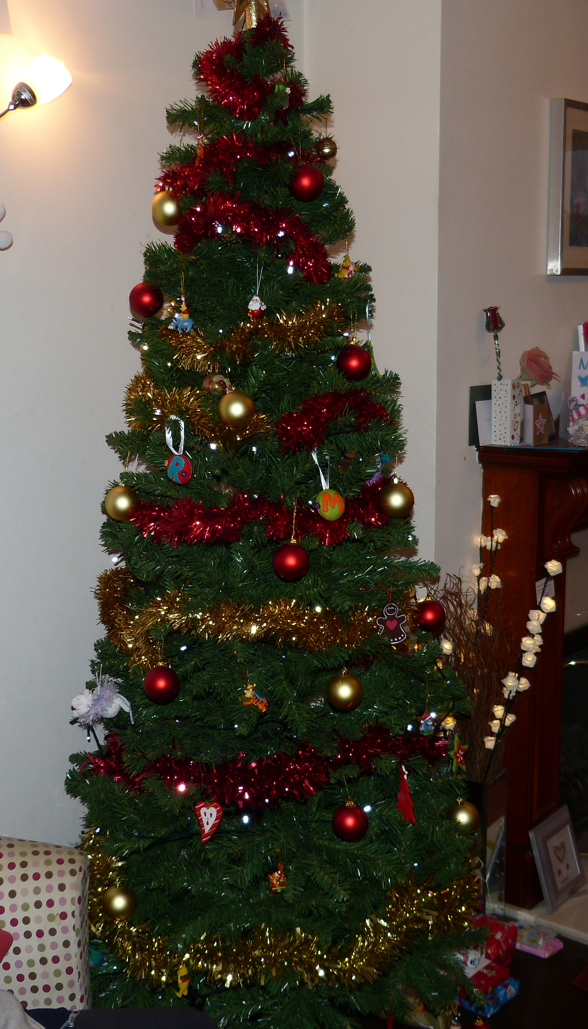
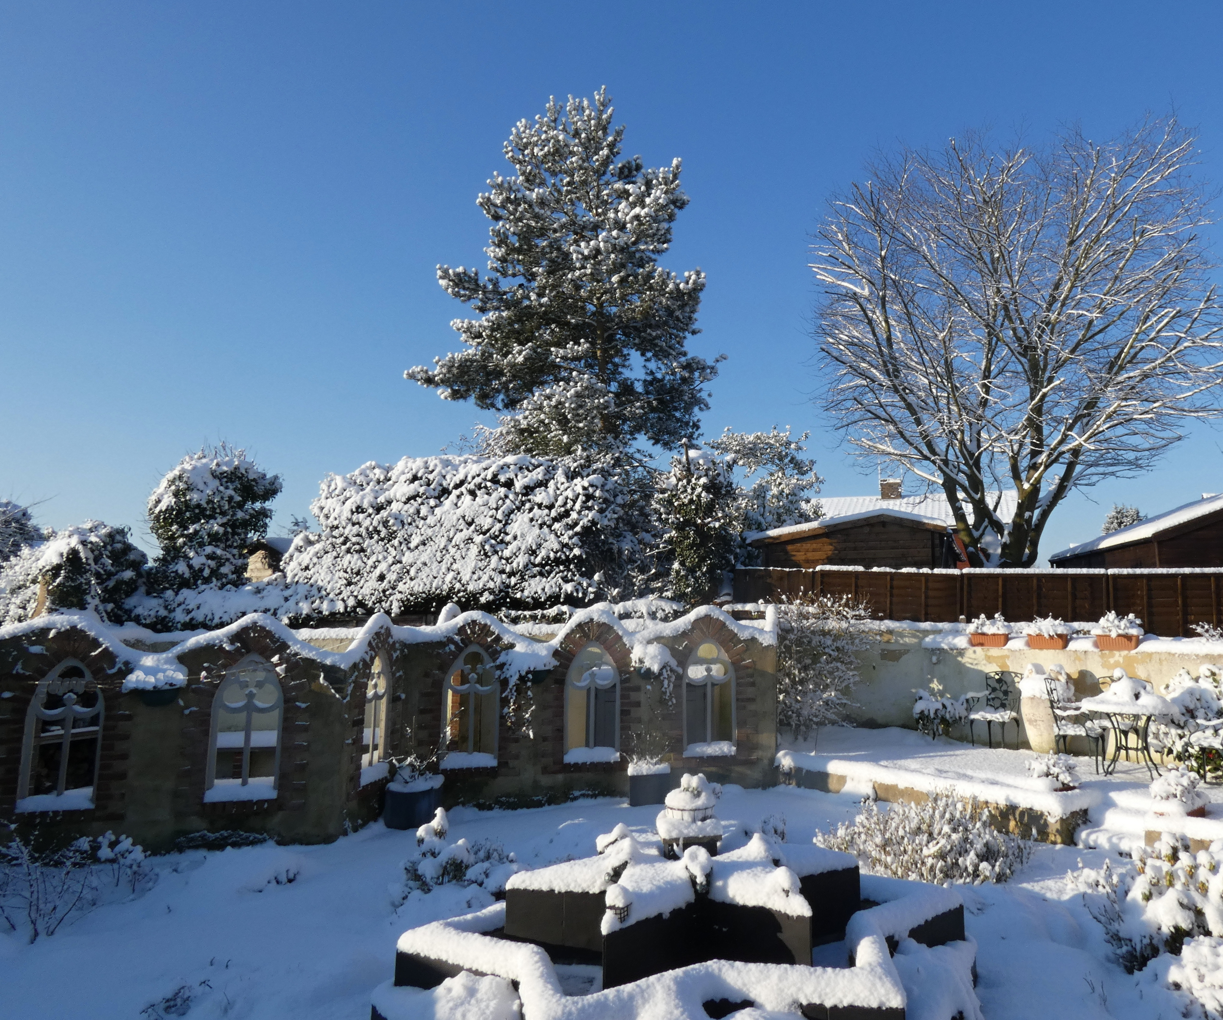
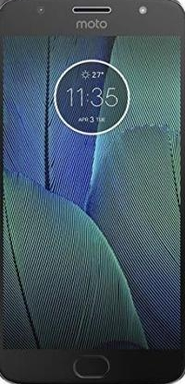
Distractions at Christmas
You Tube
Spotify
Facebook
Twitter
Tumblr
Skype
X Box
PlayStation

Slide 2
Distractions at Christmas
Mary’s distractions

Slide 3
Distractions at Christmas
Mary’s distractions
Joseph’s distractions

Slide 4
Distractions at Christmas
Mary’s distractions
Joseph’s distractions
Our distractions

Slide 5
Distractions at Christmas
Mary’s distractions
Joseph’s distractions
Our distractions
Remaining focussed

Slide 6
Distractions at Christmas
Mary’s distractions
Joseph’s distractions
Our distractions
Remaining focussed
“Rejoice in the Lord always. I will say it again: Rejoice!” Phil.4:4

Slide 7
Distractions at Christmas
Mary’s distractions
Joseph’s distractions
Our distractions
Remaining focussed
“Rejoice in the Lord always. I will say it again: Rejoice!” Phil.4:4
Our reason for joy = the Lord

Slide 8
Distractions at Christmas
Mary’s distractions
Joseph’s distractions
Our distractions
Remaining focussed
“Rejoice in the Lord always. I will say it again: Rejoice!” Phil.4:4
Our reason for joy = the Lord
Where is our focus?

Slide 9
Distractions at Christmas
Mary’s distractions
Joseph’s distractions
Our distractions
Remaining focussed
“Rejoice in the Lord always. I will say it again: Rejoice!” Phil.4:4
Our reason for joy = the Lord
Where is our focus?
People get in the way!

Slide 10
Distractions at Christmas
Mary’s distractions
Joseph’s distractions
Our distractions
Remaining focussed
“Rejoice in the Lord always. I will say it again: Rejoice!” Phil.4:4
Our reason for joy = the Lord
Where is our focus?
People get in the way!
What did Paul do?

Slide 11
Distractions at Christmas
Mary’s distractions
Joseph’s distractions
Our distractions
Remaining focussed
“Rejoice in the Lord always. I will say it again: Rejoice!” Phil.4:4
Our reason for joy = the Lord
Where is our focus?
People get in the way!
What did Paul do?
Need for Christlike behaviour

Slide 12
Distractions at Christmas
Mary’s distractions
Joseph’s distractions
Our distractions
Remaining focussed
“Rejoice in the Lord always. I will say it again: Rejoice!” Phil.4:4
Our reason for joy = the Lord
Where is our focus?
People get in the way!
What did Paul do?
Need for Christlike behaviour
Pray with thanksgiving

Slide 13
Distractions at Christmas
Mary’s distractions
Joseph’s distractions
Our distractions
Remaining focussed
Conclusions

Slide 14
Distractions at Christmas
Mary’s distractions
Joseph’s distractions
Our distractions
Remaining focussed
Conclusions
1. Remember reason for our joy

Slide 15
Distractions at Christmas
Mary’s distractions
Joseph’s distractions
Our distractions
Remaining focussed
Conclusions
Remember reason for our joy
Spread the reason for our joy

